Slide 1
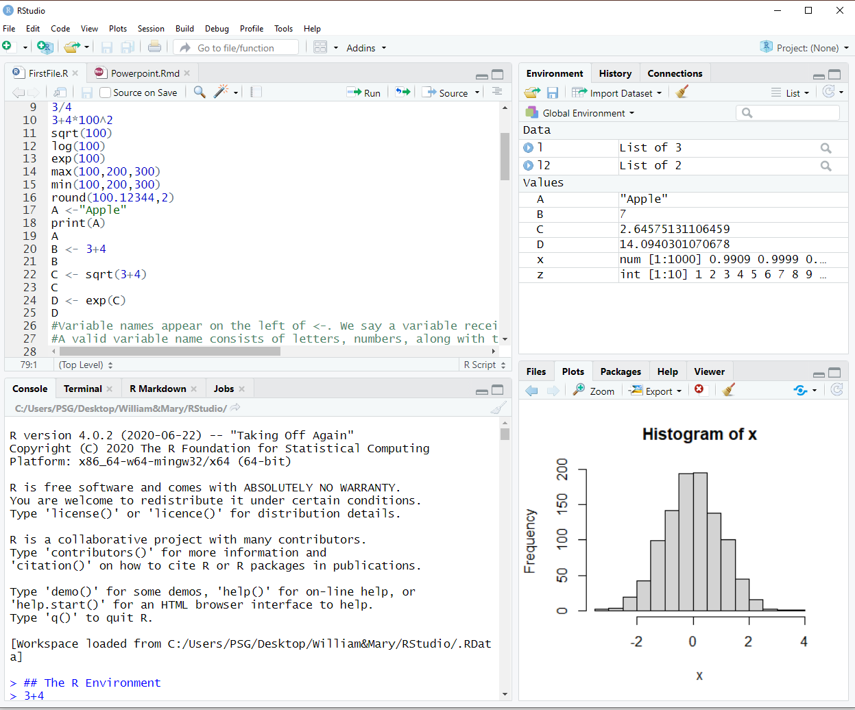
Getting Started with R and RStudio
Section 2.3

Slide 2
History of R
1976 – S Language at Bell Labs – originally part of AT&T
1991 – R released University of Auckland with S-Plus for commercial implementation
1995 – R released under GPL – R becomes free and open-source
1999 – The R website, r-project.org was founded
2000 – R 1.0 was released to the public
2004 – R 2.0 was released
2013 – R 3.0 was released
2017 – CRAN exceeds 10,000 published packages
July 2020 – R 4.0 was released

Slide 3
Things to Know in R to Say That You Know R
Troubleshooting
Environment
Assignment
Sequence
Using Built In Functions
Reading Data
Working with Packages
Writing Functions
Conditional Statements
Rendering Output

Slide 4
R and Packages
RStudio is a graphical user interface for R that allows you to write, edit, and store code, generate, view, and store plots, manage files, objects and data frames, and integrate with version control systems to name a few of its functions.
People have developed packages to expand upon R's basic functionality. A package is a collection of functions, data, and code conveniently provided in a nice complete format for you. There is an ever expanding number of packages.
A library is the place where the package is located on your computer.
A repository is a central location where many developed packages are located and available for download. There are three big repositories.
Comprehensive R Archive Network, or CRAN, which is R's main repository with over 12,100 packages available.
There is also the Bioconductor repository, which is mainly for Bioinformatic focus packages.
Finally, there is GitHub, a very popular, open source repository that is not R specific.

Slide 5
Troubleshooting Errors in RStudio
Step 1: Restart RStudio/Restart Computer
Step 2: Use rm(list=ls()) to clear out old variables
Make sure proper capitalization and spacing is being used.
Step 3: Reading the manuals or help files. For our problems, try typing question mark command. ?command
Step 4: Searching on Google and searching relevant forums.
Step 5: Post a question on our internal discussion board.
These questions cannot ask someone to answer part or all of the question, but can involve issues with MAC’s or PC or installation of packages.
General categories of errors
Your command produces no data and gives you an error message
Your command produces an incorrect output.

Slide 6
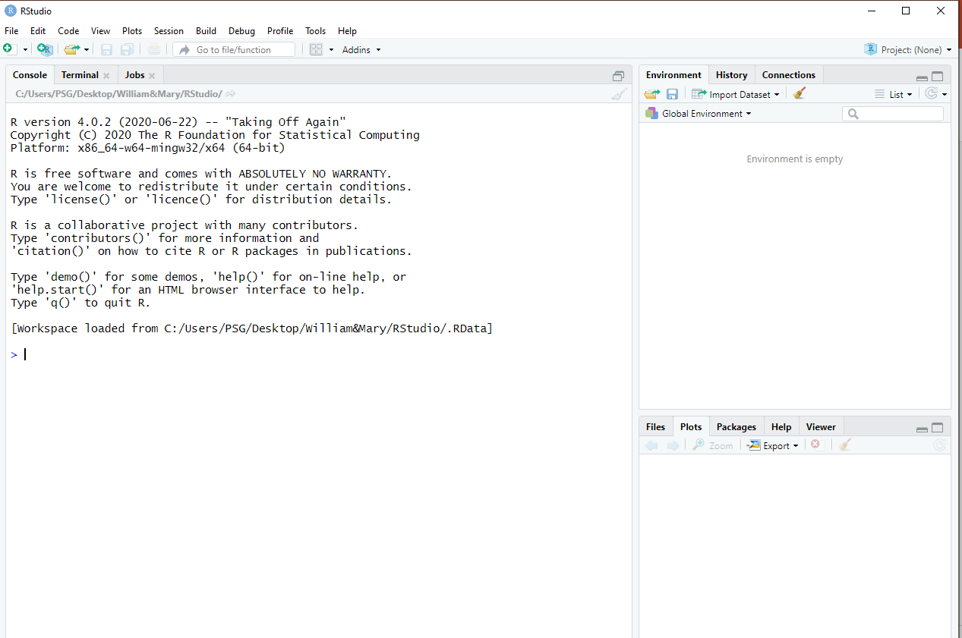
Taking a look at R Studio
When you open R - On the left is the Console Window
Reproduces the R environment
Observe the command line
On the right, two windows, each
with tabs
Can resize the windows using the splitters
Can maximize/restore the windows within the left/right panels using the familiar Windows controls in the upper-right of each window
Can customize using the View menu item
You can zoom into a particular window using the Zoom tool on the toolbar View menu item (or permanently in Tools/Global Options/Appearance)

Slide 7
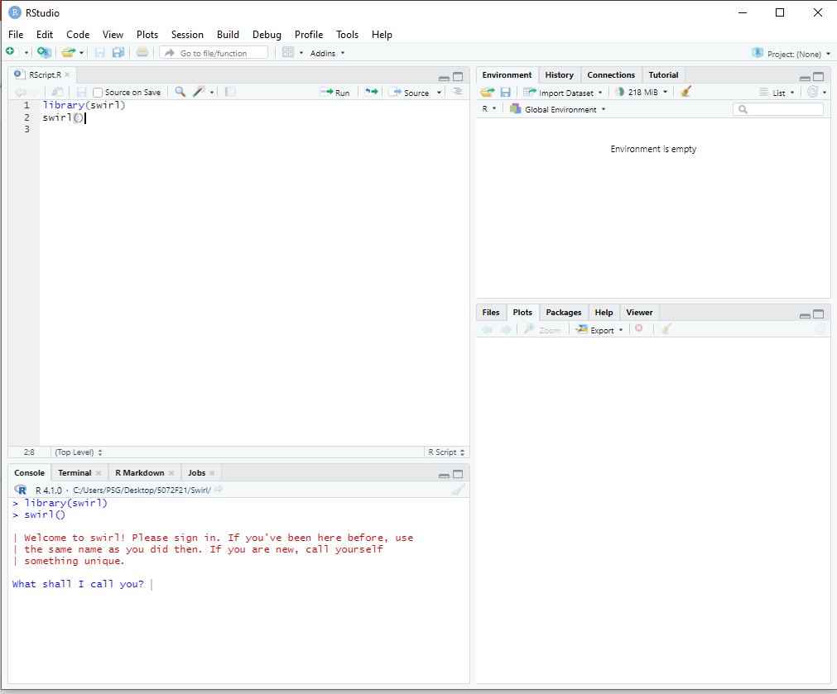
The R Environment
Go to File > New File> Rscript to start a new Rscript file. Save that file on your harddrive as a .R file
Use Alt+Enter to run a line of code one at a time in an R Script file.
Swirl lessons are taken in the console. The work disappears when you close R Studio down.
Use Enter to run a line of code in the console.
While swirl() lessons are in the console, you should create and save R script files in class so that you can access your work a second time.

Slide 8
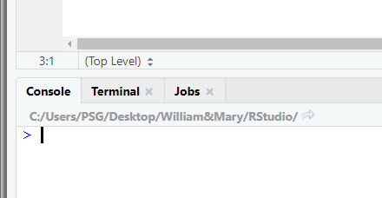
Finding and Setting Your Working Directory
getwd() to find your current working directory. This is the directory your R program and files are saving to.
setwd(‘C://file/path’) can change your working directory. Take note of the forward slash. If you look on the console, it produces this information for you to note.
Take note swirl is interactive in the console and does not save R files to your working directory.
You can also go to Tools > Global Options > General and reset your default working directory when not in a project.

Slide 9
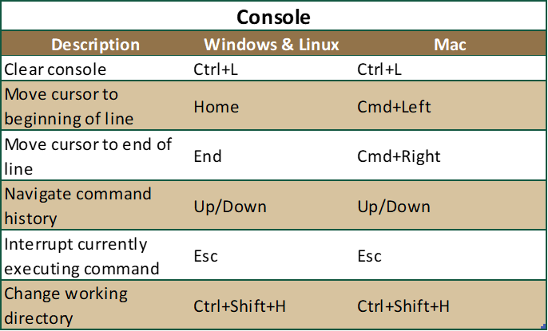
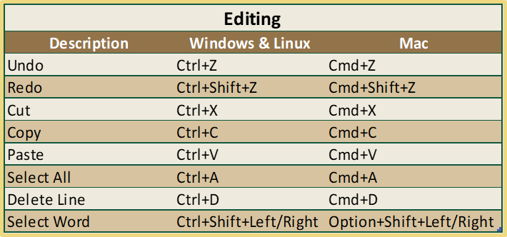
Quick Keys in R Studio
Notes:
https://support.rstudio.com/hc/en-us/articles/200711853-Keyboard-Shortcuts

Slide 10
Fundamentals in R
R Calculates Easily
R Handles Text in Multiple Ways
3+4
## [1] 7
3*4
## [1] 12
3/4
## [1] 0.75
3+4*100^2
## [1] 40003
**Order or Operations Holds in R!
'This is a string'
## [1] "This is a string"
"This is also a string"
## [1] "This is also a string"
**Notice that single quotes interchange with double quotes. But note to be careful with nested quotes.
# This is a comment for documentation
Comments are denoted by the Hash tag which you can type or push ctrl + shift + c.

Slide 11
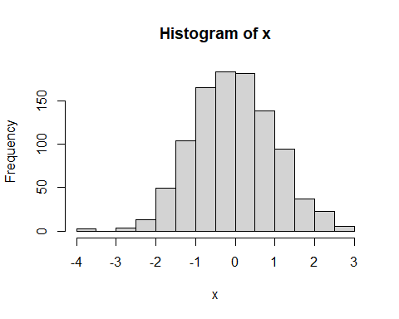
Built In Functions in R
R has tens of thousands of built in functions including those for summary statistics including Mathematical Functions, Statistical Functions, and Character Functions
sqrt(100)
## [1] 10
log(100)
## [1] 4.60517
exp(100)
## [1] 2.688117e+43
max(100,200,300)
## [1] 300
min(100,200,300)
## [1] 100
round(100.12344,2)
## [1] 100.12
#rnorm() generates a vector of random normal variables with the sample size n.
x<-rnorm(1000) mean(x)
## [1] -0.03689346
sd(x)
## [1] 1.017123
median(x)
## [1] -0.05017835
hist(x)

Slide 12
Variable Rules
Variable names appear on the left of <-. We say a variable receives or is assigned the value of the expression on the right.
A valid variable name consists of letters, numbers, along with the dot or underline characters.
A variable name must start with a letter or the dot (when not followed by a number).
A variable cannot contain spaces.
Some punctuation has meaning to R and should be avoided.
Variables are case sensitive: x is different from X just as Reg is different from REG.
The value on the right must be a number, string, an expression, or another variable.
A <-"Apple" print(A)
## [1] "Apple"
A
## [1] "Apple"
B <- 3+4 B
## [1] 7
C <- sqrt(3+4) C
## [1] 2.645751
D <- exp(C) D
## [1] 14.09403
Notice print(A) and A give you the same output

Slide 13
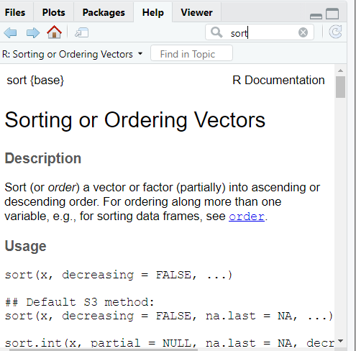
Arguments in R
Always look up a built in function to see the arguments you can use.
Arguments are always named when you define a function.
When you call a function, you do not have to specify the name of the argument.
Arguments have default values, which is used if you do not specify a value for that argument yourself.
An argument list comprises of comma-separated values that contain the various formal arguments.
Default arguments are specified as follows:
parameter = expression
x<-10:20 sort(x)
## [1] 10 11 12 13 14 15 16 17 18 19 20
sort(x, decreasing=FALSE)
## [1] 10 11 12 13 14 15 16 17 18 19 20

Slide 14
R is called a Dynamically Typed Language
In R, a variable itself is not declared of any data type. Rather it receives the data type of the R object that is assigned to it.
We can change a variable’s data type if we want, but it will inherit one based on the object assigned to it.
A; class(A)
## [1] "Apple"
## [1] "character"
B; class(B)
## [1] 7
## [1] "numeric"
C; class(C)
## [1] 2.645751
## [1] "numeric"
# The semicolon separates commands on the same line.

Slide 15
Sequence - Vector and Vector Functions
A vector is the simplest type of data structure in R.
A vector is a sequence of data elements of the same basic type.
Technically, a vector can have as little as 1 data element but then it is called scalar.
c(1,2,3,4,5) ##Print a Vector 1:5
## [1] 1 2 3 4 5
1:5 ##Print a Vector 1:5
## [1] 1 2 3 4 5
seq(0,30,by=5) ##Make a Sequence Vector from 0 to 30 in increments on 5
## [1] 0 5 10 15 20 25 30
rep(1:3,times=4) ##repeat the elements of the vector 4 times
## [1] 1 2 3 1 2 3 1 2 3 1 2 3
rep(1:3, each=3) ##repeat the elements of a vector 3 times each
## [1] 1 1 1 2 2 2 3 3 3

Slide 16
Vector Functions with Variables
x<-c(1,2,3,3,100,-10,40) sort(x) ##Sort the Vector Small to Large
## [1] -10 1 2 3 3 40 100
rev(x) ##Reverse the Vector
## [1] 40 -10 100 3 3 2 1
unique(x) ##Does Not Print Duplicate Values of X
## [1] 1 2 3 100 -10 40
max(x) ##Largest Element
## [1] 100
min(x) ##Smallest Element
## [1] -10

Slide 17
Selecting Vector Elements
z<-1:10; z #Make a vector 1 through 10 and print the vector
## [1] 1 2 3 4 5 6 7 8 9 10
z[10] #Pull the value in the 10th spot.
## [1] 10
z[5:10] #Print the values in spots 5 through 10
## [1] 5 6 7 8 9 10
z[-5] #Print all values besides 5
## [1] 1 2 3 4 6 7 8 9 10
z[-(5:7)] #Print all values besides 5 through 7
## [1] 1 2 3 4 8 9 10
z[c(1,2,5)] # Print values in spots 1, 2, and 5
## [1] 1 2 5

Slide 18
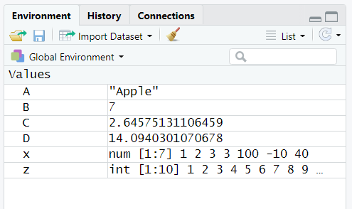
The Environment
Evaluate your Environment Tab to see your Variables we have defined in R Studio.

Slide 19
The Environment Inspector
Look at the variables we have defined. Your list might have more or less than me depending on if you added others or did not clean out your environment prior to starting.
ls()
## [1] "A" "B" "C" "D" "x" "z"
rm(A) rm(list=ls())
I made a note in swirl about rm(list=ls()). Take note how useful it is. You should clear your global environment upon R startup.

Slide 20
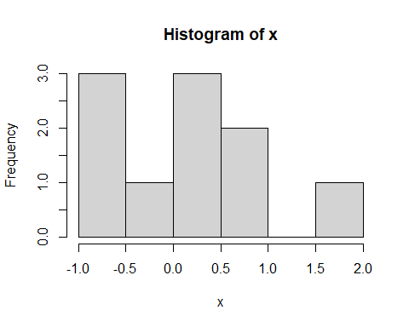
Setting the Seed
set.seed(1) ## You can select a number to set the seed. x<- rnorm(10,mean=0,sd=1) #default values for mean = 0 and sd = 1 without these arguments. x
## [1] -0.6264538 0.1836433 -0.8356286 1.5952808 0.3295078 -0.8204684 ## [7] 0.4874291 0.7383247 0.5757814 -0.3053884
mean(x)
## [1] 0.1322028
sd(x)
## [1] 0.780586
hist(x)

Slide 21
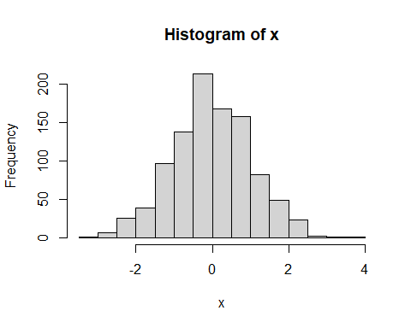
Increase Sample Size
set.seed(1) ## You can select a number to set the seed. x<- rnorm(1000,mean=0,sd=1)
#Having more data means you will get closer to the mean. mean(x)
## [1] -0.01164814
sd(x)
## [1] 1.034916
hist(x)

Slide 22
Matrix
Matrix is another type of object like a vector or a list
x<-1:9 #Creating a Variable X that has 9 Values.
matrix(x, nrow=3, ncol=3) #Using matrix() function to create a matrix with 3 rows and 3 columns.
## [,1] [,2] [,3] ## [1,] 1 4 7 ## [2,] 2 5 8 ## [3,] 3 6 9
matrix(1:9,3,3) ##Take note how the matrix fills in the new data.
## [,1] [,2] [,3] ## [1,] 1 4 7 ## [2,] 2 5 8 ## [3,] 3 6 9
Note – we do not need to name the arguments because we go in the correct order.

Slide 23
Setting byrow Argument in a Matrix
m<-matrix(1:9,3,3,byrow=TRUE) m
## [,1] [,2] [,3] ## [1,] 1 2 3 ## [2,] 4 5 6 ## [3,] 7 8 9
##Fills the Matrix Across the Row and assigns it to variable m

Slide 24
Indexing a Matrix
m<-matrix(1:9,3,3,byrow=TRUE) m
## [,1] [,2] [,3] ## [1,] 1 2 3 ## [2,] 4 5 6 ## [3,] 7 8 9
m[1,] #select the first row
## [1] 1 2 3
m[,1] #select the first column
## [1] 1 4 7
m[1,2] #select an element in the first row and second column
## [1] 2
#Use the negative sign to tell R to keep all rows or columns except those indicated m[-1,]
## [,1] [,2] [,3] ## [1,] 4 5 6 ## [2,] 7 8 9
m[-c(1,3),]##if it is not an array, you need the c() function to combine values.
## [1] 4 5 6
m[-(1:2),]##Note the parentheses
## [1] 7 8 9

Slide 25
Data Frame
A data frame is a table or a two-dimensional array-like structure in which each column contains values of one variable and each row contains one set of values from each column.
Similarly, in R – they are generic data objects to store tabular data.
The column names should be non-empty.
The row names should be unique.
The data stored in a data frame can be of numeric, factor or character type.
Each column should contain same number of data items.
library(MASS) data("Insurance") head(Insurance)
## District Group Age Holders Claims ## 1 1 <1l <25 197 38 ## 2 1 <1l 25-29 264 35 ## 3 1 <1l 30-35 246 20 ## 4 1 <1l >35 1680 156 ## 5 1 1-1.5l <25 284 63 ## 6 1 1-1.5l 25-29 536 84
In a data frame the columns contain different types of data, but in a matrix all the elements are the same type of data. A matrix is usually numbers.
The matrix can be looked at as a vector with additional methods or dimensions, while a data frame is a list.

Slide 26
Lists in R
A list is a collection of elements which can have different data types.
These elements do not have any restriction on the class, length or structure of each element
Data frames are lists, but they have a few restrictions mentioned above:
you can't use the same name for two different variables
all elements of a data frame are vectors
all elements of a data frame have an equal length.
A data frame fits a dataset that is a 2 dimensional structure.
l<- list(1234,'Machine Learning’,’BUAD5072') l[1] ##The value in the first position of the list
## [[1]] ## [1] 1234
l[2] ##The value in the second position of the list
## [[1]] ## [1] "Machine Learning"
l2<-list(Employee=c("Sally“),Salary=c(40000)) l2$Employee ##List values can be accessed by name using the $
## [1] "Sally"
l2[['Employee']] ##List values can be accessed with double brackets and quotations
## [1] "Sally"

Slide 27
Inspecting Data Structures: All incredibly useful functions for Analytics
The str() function helps you look at data structures and compactly displays the internal structure of an R object.
l2<-list(Employee="Sally",Salary=40000)
str(l2)
## List of 2 ## $ Employee: chr "Sally" ## $ Salary : num 40000
library(MASS); data("Insurance")
str(Insurance)
## 'data.frame': 64 obs. of 5 variables: ## $ District: Factor w/ 4 levels "1","2","3","4": 1 1 1 1 1 1 1 1 1 1 ... ## $ Group : Ord.factor w/ 4 levels "<1l"<"1-1.5l"<..: 1 1 1 1 2 2 2 2 3 3 ... ## $ Age : Ord.factor w/ 4 levels "<25"<"25-29"<..: 1 2 3 4 1 2 3 4 1 2 ... ## $ Holders : int 197 264 246 1680 284 536 696 3582 133 286 ... ## $ Claims : int 38 35 20 156 63 84 89 400 19 52 ...
The class() function finds the class the object belongs to.
class(l2)
## [1] "list"
class(Insurance)
## [1] "data.frame"
The summary() function gives you more detailed information on a data structure.
summary(l2)
## Length Class Mode ## Employee 1 -none- character ## Salary 1 -none- numeric
summary(Insurance)
## District Group Age Holders Claims ## 1:16 <1l :16 <25 :16 Min. : 3.00 Min. : 0.00 ## 2:16 1-1.5l:16 25-29:16 1st Qu.: 46.75 1st Qu.: 9.50 ## 3:16 1.5-2l:16 30-35:16 Median : 136.00 Median : 22.00 ## 4:16 >2l :16 >35 :16 Mean : 364.98 Mean : 49.23 ## 3rd Qu.: 327.50 3rd Qu.: 55.50 ## Max. :3582.00 Max. :400.00

Slide 28
For Next Time
Work through Loading_Data Swirl lesson to get a sense of what you can do.

